Slide 1
AI software integration - Floyd Furniture
Sagnik Das
Sania Bhojwani
Fatima Sayyed
Vedant Patil

Slide 2
Overview
The primary objective is to integrate Neurala's AI visual inspection software into Floyd Furniture's manufacturing quality assurance process which will enhance quality control for organization’s products which in turn will increase production scale and customer satisfaction level.
Some of the key affects for the project is mentioned in brief:
Project Objective: Implement Neurala AI visual inspection software at Floyd Furniture to improve quality at scale.
Business Rationale: Enhance product quality, increase efficiency, and maintain competitive advantage.
Process Deliverables: Detailed project plan, stakeholder engagement, and quality control measures.
Product Deliverables: Integration of Neurala AI software, improved quality control processes, and training materials for staff.

Slide 3
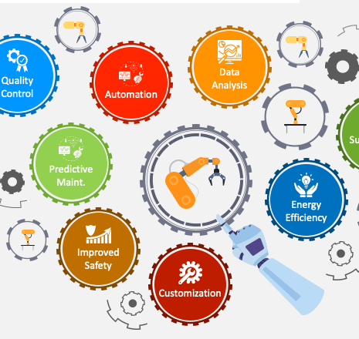
Vision of the Project and Technology Outcomes
Vision: Enhanced quality control with AI-driven inspection, streamlined manufacturing processes.
Changes for Staff/Customers: Staff will be trained on new software; customers will experience improved product quality. Organization will have associates well versed with new AI technologies and strategies.
Strategic Advantages: Increased efficiency, reduced errors, enhanced customer satisfaction, and strengthened market position.

Slide 4
Scheduling Assumptions and Constraints
Assumptions: Successful integration of Neurala AI with existing systems, availability of key staff and resources.
Neurala's VIA software will integrate with Floyd's existing systems without any limitation.
Availability of project team members and cooperation from Neurala
Neurala's VIA software will remediate the entire quality control issues
Dependencies: Collaboration with Salesforce, timely legal approvals, and investor funding.
Constraints: Fixed project timeline, budget limitations, and resource availability.

Slide 5
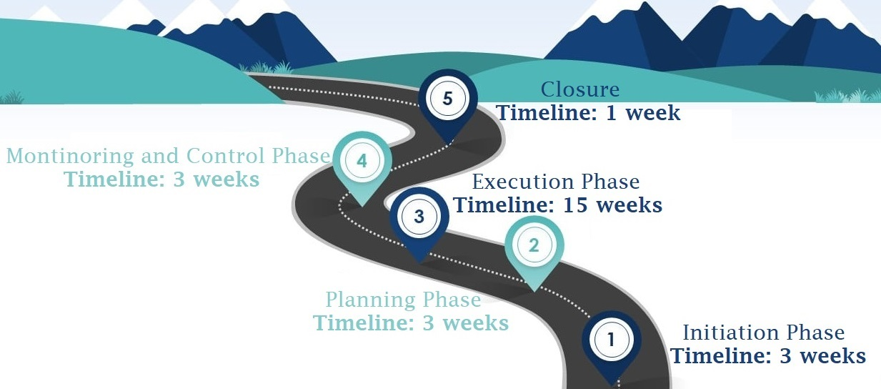
Project Stages
Initiation: Charter-Scope document approval, team formation.
Planning: Detailed project planning, stakeholder engagement.
Execution: Software integration, staff training, quality control implementation.
Monitoring and Control: Continuous monitoring, quality assurance, and adjustments.
Closure: Final evaluation, documentation, and project handover.

Slide 6
Quality Planning, Assurance, and Control Approaches
Quality Planning:
Quality Assurance:
Quality Control:
Cross-Functional Integration:
Continuous Improvement:
Establishing guidelines and procedures to guarantee that Floyd Furniture's quality standards are met when integrating Neurala AI.
Approach:
Establish quality metrics for furniture quality and the accuracy of AI inspections.
Identify critical quality checkpoints throughout the manufacturing process.
Arrange for frequent quality audits to evaluate the AI system's effectiveness.
Ensuring that the project complies with the established quality standards and guidelines.
Implement continuous monitoring of AI system performance.
Educate employees on the new quality requirements through training sessions, and ensure compliance
Discuss AI inspection results with stakeholders on a regular basis, and measure accuracy by contrasting them with manual inspection results.
To identify and fix any quality problems that arise while the product is being manufactured.
Approach:
Constant observation of furniture components with real-time Neurala AI inspection.
Establish a feedback loop between the AI system and production teams for immediate corrective actions.
Track after-delivery customer feedback to find any quality problems that were missed during production.
Salesforce CRM Integration: For thorough quality tracking and reporting, seamlessly incorporate Neurala AI quality data into Floyd's Salesforce CRM.
Feedback and Adaptation: Review quality measurements on a regular basis and modify the AI system as needed to ensure that standards of quality are continuously raised.
Approach:

Slide 7
Executive Involvement and Support Needed
Josh Oswald (Project Sponsor):
Role: Provides strategic guidance and ensures adequate resource allocation for the project.
Rachael Brown (VP of Marketing):
Role: Ensures the marketing strategy is aligned with the project goals and engages with key stakeholders.
Ashley Bishay (Financial Controller):
Role: Oversees the project budget and gives financial approvals.
Aurelia Johnson (Salesforce):
Role: Provides technical support and assistance with the integration of Neurala AI into Floyd’s Salesforce CRM.
Investors:
Role: Offer continued funding and strategic support for the project.
Floyd Furniture Project Managers:
Sagnik Das, Sania Bhojwani, Fatima Sayyed, Vedant Patil
Role: Coordinate and oversee the planning, execution, and timely delivery of the project, ensuring effective communication and collaboration among all stakeholders.

Slide 8

Thank you!
Questions?

